Slide 1



Hospitality Project
View in Power BI
Last data refresh:
11-08-2026 17:36:48 UTC
Downloaded at:
11-08-2026 17:42:14 UTC

Slide 2
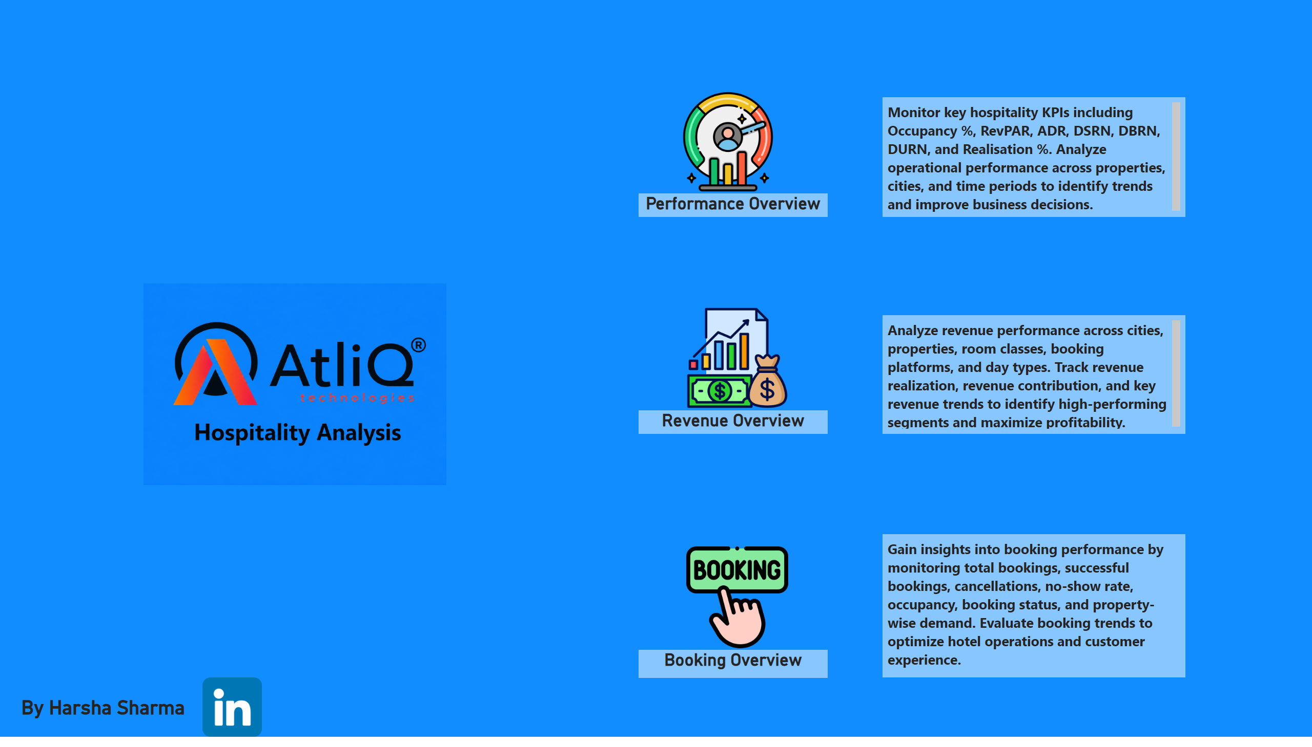
Home Page
Notes:
image
No alt text provided
Revenue Overview
No alt text provided
textbox
No alt text provided
image
No alt text provided
image
No alt text provided
Booking Overview
No alt text provided
By Harsha Sharma
No alt text provided
textbox
No alt text provided
Performance Overview
No alt text provided
image
No alt text provided
textbox
No alt text provided
image
No alt text provided

Slide 3
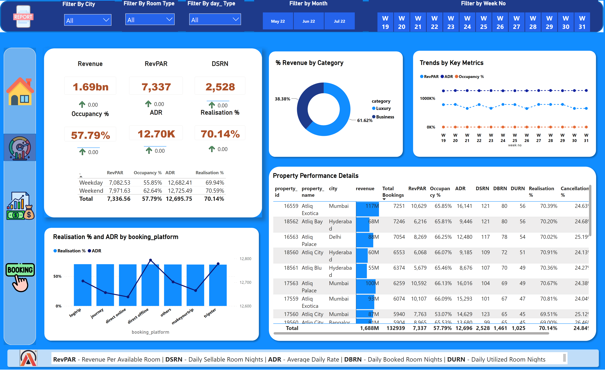
Performanace Overview
Notes:
DSRN
No alt text provided
image
No alt text provided
image
No alt text provided
shape
No alt text provided
Realisation %
No alt text provided
% Revenue by Category
No alt text provided
ADR
No alt text provided
Report Switch
No alt text provided
shape
No alt text provided
shape
No alt text provided
image
No alt text provided
image
No alt text provided
image
No alt text provided
shape
No alt text provided
shape
No alt text provided
tableEx
No alt text provided
Occupancy %
No alt text provided
shape
No alt text provided
tableEx
No alt text provided
textbox
No alt text provided
tableEx
No alt text provided
tableEx
No alt text provided
image
No alt text provided
Revenue
No alt text provided
image
No alt text provided
shape
No alt text provided
Trends by Key Metrics
No alt text provided
Filter by Week No
No alt text provided
lineStackedColumnComboChart
No alt text provided
Filter By day_ Type
No alt text provided
image
No alt text provided
Filter by Month
No alt text provided
tableEx
No alt text provided
shape
No alt text provided
shape
No alt text provided
tableEx
No alt text provided
Filter By Room Type
No alt text provided
shape
No alt text provided
RevPAR
No alt text provided
Filter By City
No alt text provided
image
No alt text provided
tableEx
No alt text provided
Property Performance Details
No alt text provided

Slide 4
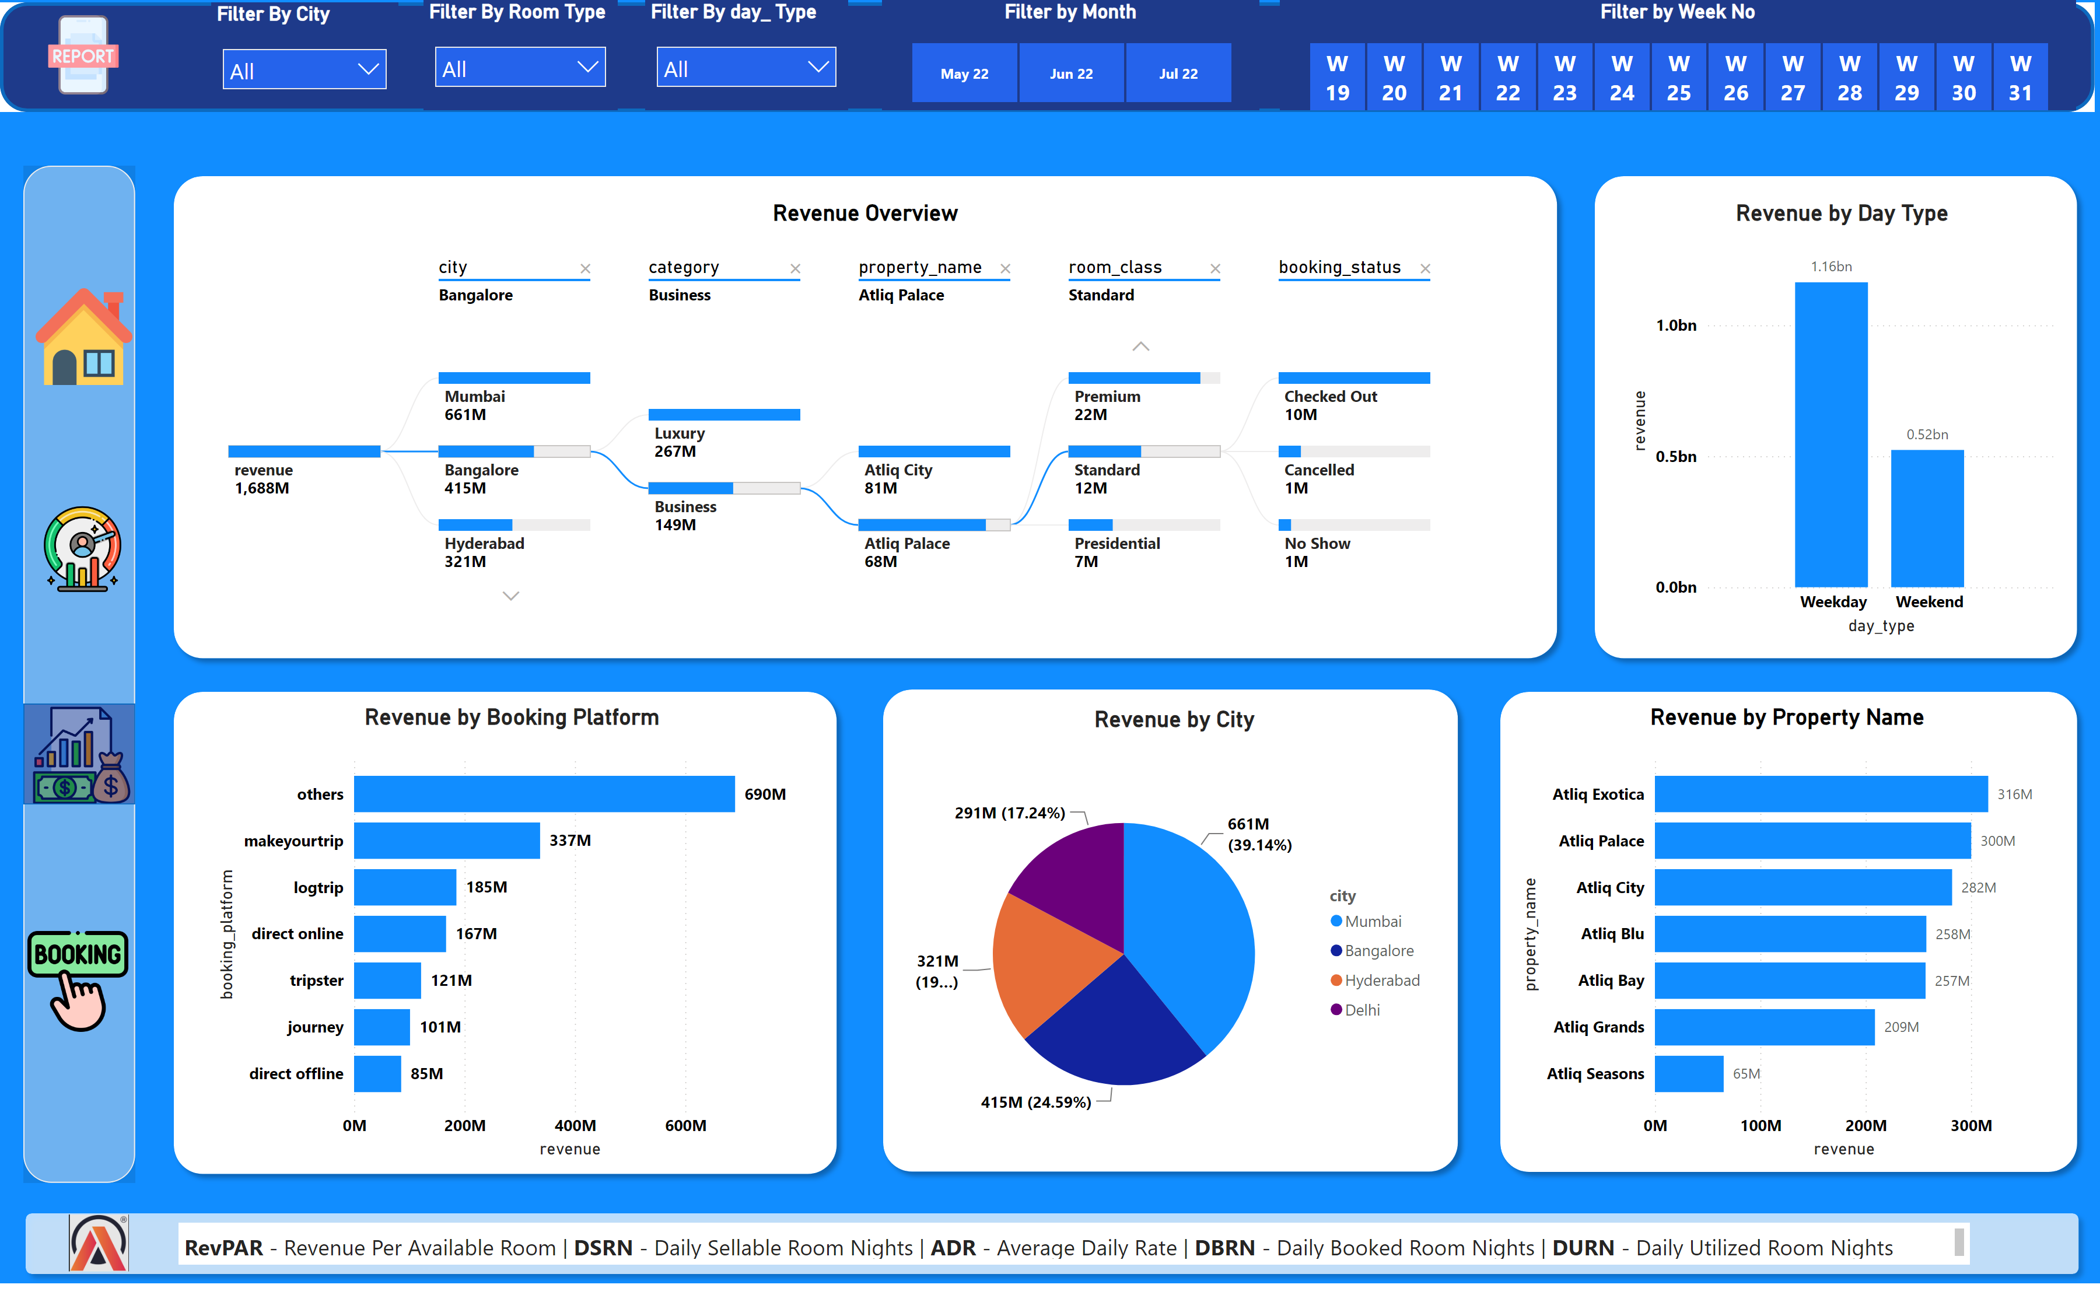
Revenue Overview
Notes:
shape
No alt text provided
Report Switch
No alt text provided
Filter By City
No alt text provided
Revenue by Booking Platform
No alt text provided
shape
No alt text provided
image
No alt text provided
image
No alt text provided
shape
No alt text provided
Revenue by Day Type
No alt text provided
image
No alt text provided
shape
No alt text provided
Revenue by Property Name
No alt text provided
image
No alt text provided
textbox
No alt text provided
image
No alt text provided
image
No alt text provided
shape
No alt text provided
image
No alt text provided
shape
No alt text provided
shape
No alt text provided
shape
No alt text provided
Revenue Overview
No alt text provided
Filter by Month
No alt text provided
Revenue by City
No alt text provided
Filter by Week No
No alt text provided
shape
No alt text provided
Filter By day_ Type
No alt text provided
shape
No alt text provided
image
No alt text provided
Filter By Room Type
No alt text provided
image
No alt text provided

Slide 5
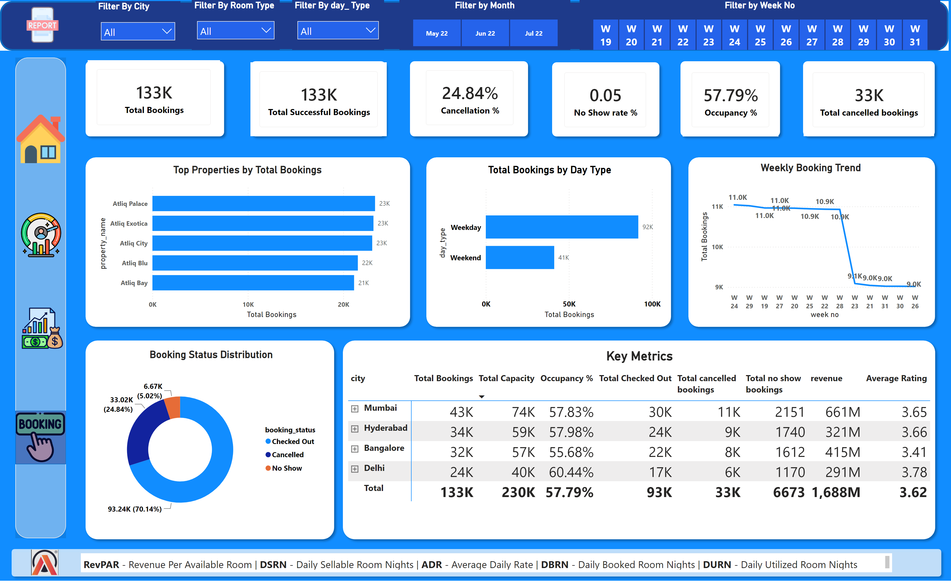
Booking Overview
Notes:
Filter By day_ Type
No alt text provided
shape
No alt text provided
shape
No alt text provided
cardVisual
No alt text provided
image
No alt text provided
image
No alt text provided
shape
No alt text provided
shape
No alt text provided
shape
No alt text provided
image
No alt text provided
image
No alt text provided
shape
No alt text provided
shape
No alt text provided
image
No alt text provided
image
No alt text provided
image
No alt text provided
shape
No alt text provided
Weekly Booking Trend
No alt text provided
Filter By City
No alt text provided
cardVisual
No alt text provided
shape
No alt text provided
Top Properties by Total Bookings
No alt text provided
shape
No alt text provided
shape
No alt text provided
shape
No alt text provided
shape
No alt text provided
Filter By Room Type
No alt text provided
Report Switch
No alt text provided
shape
No alt text provided
cardVisual
No alt text provided
textbox
No alt text provided
image
No alt text provided
Total Bookings by Day Type
No alt text provided
image
No alt text provided
Filter by Month
No alt text provided
cardVisual
No alt text provided
Booking Status Distribution
No alt text provided
Filter by Week No
No alt text provided
shape
No alt text provided
Key Metrics
No alt text provided
cardVisual
No alt text provided
cardVisual
No alt text provided
shape
No alt text provided

